Slide 1


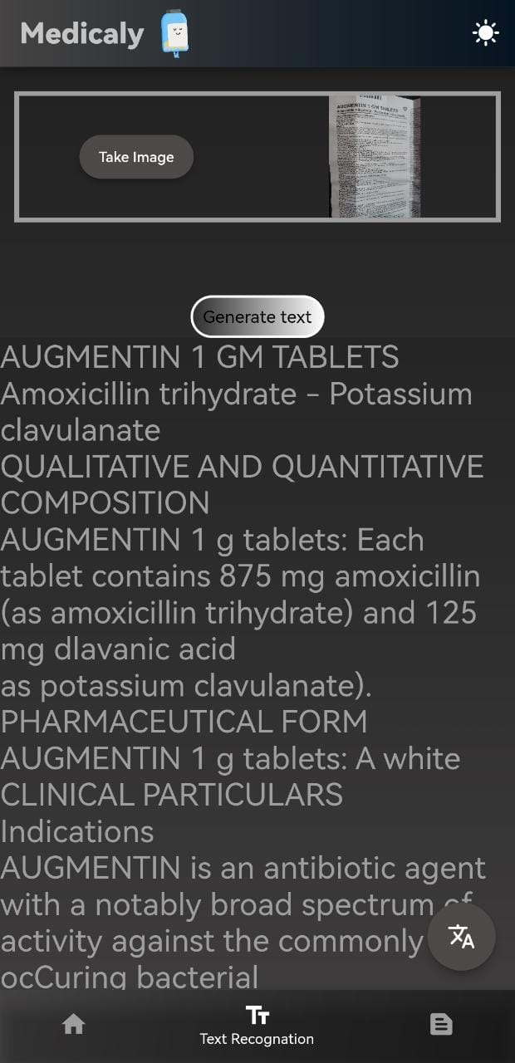
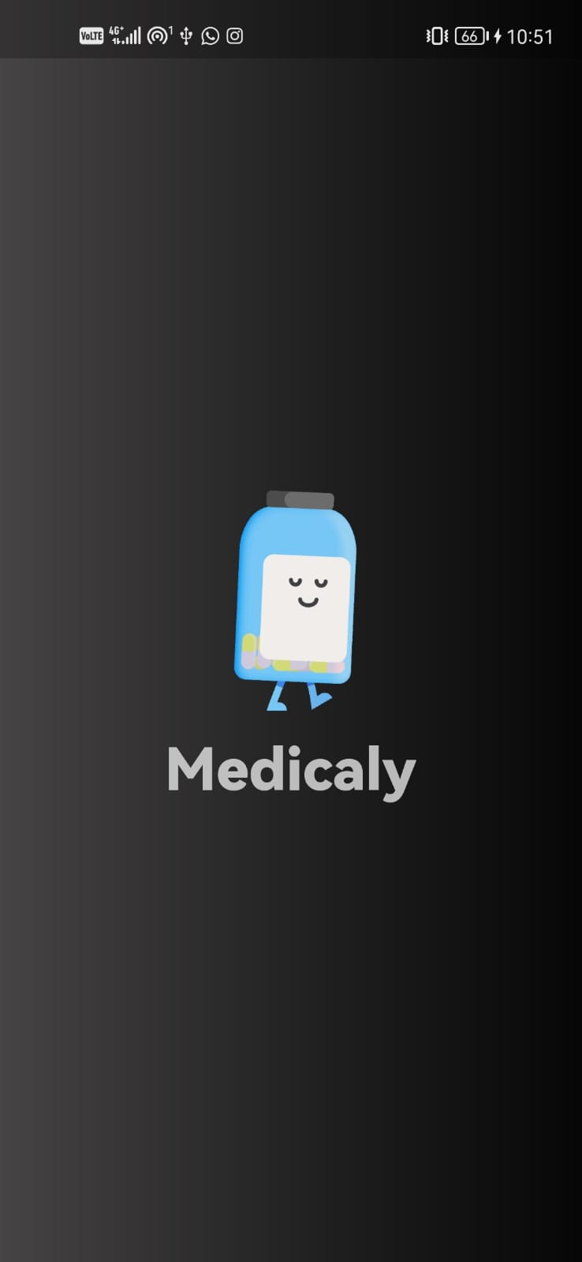
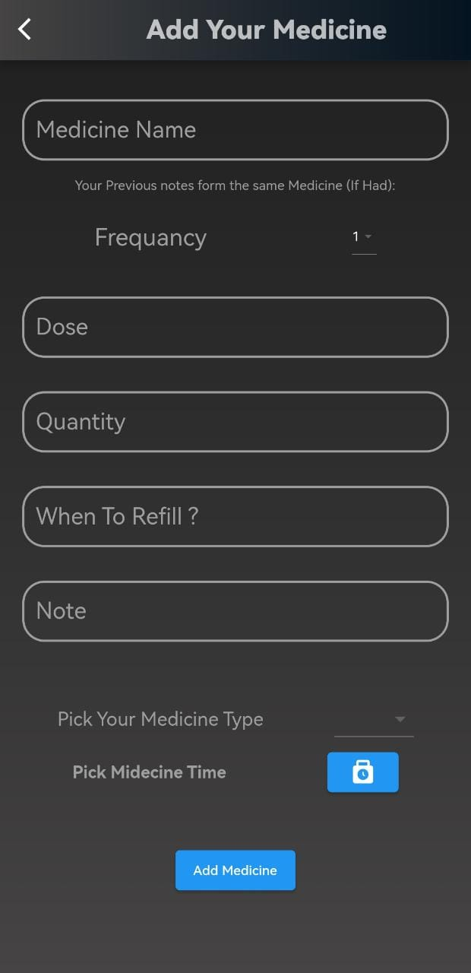
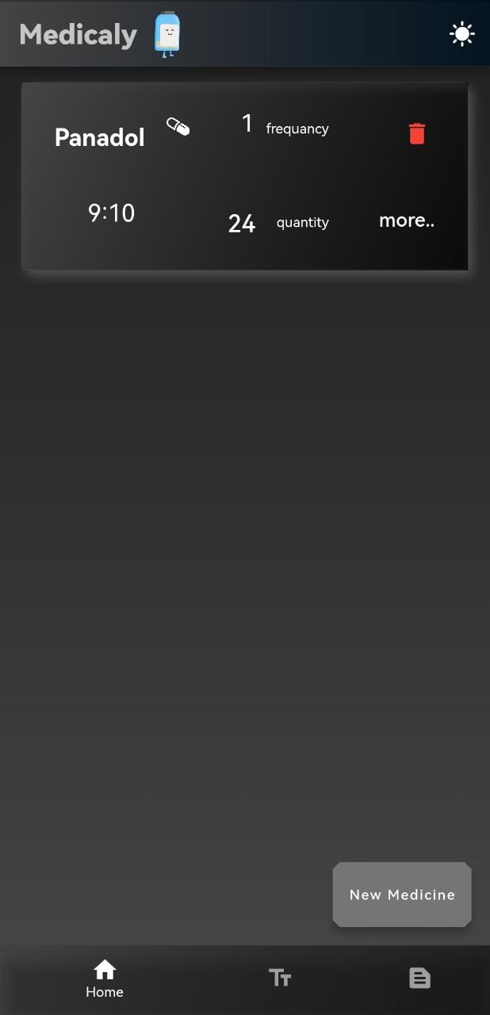
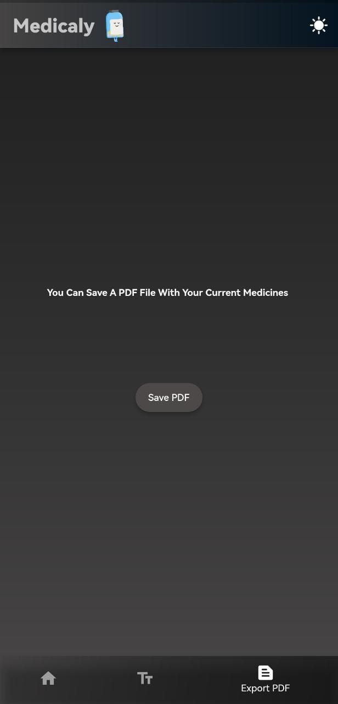
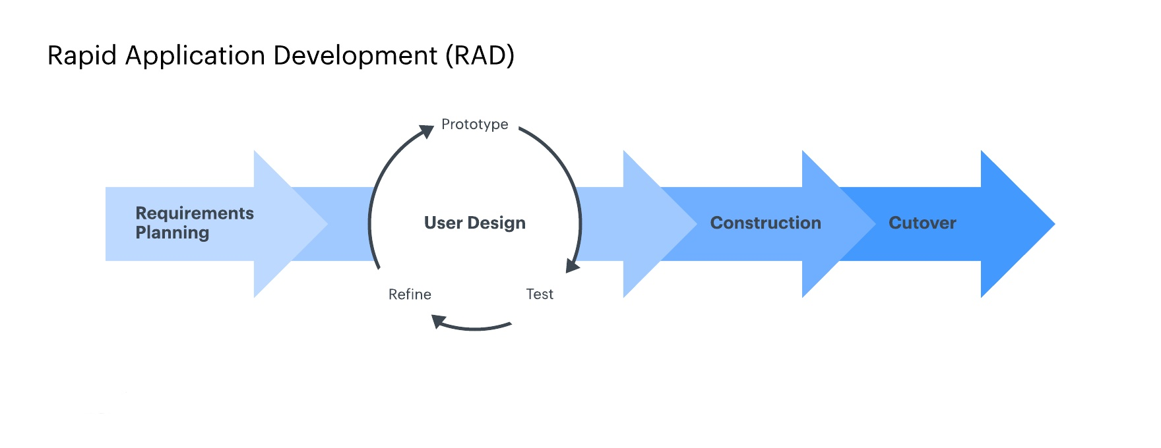
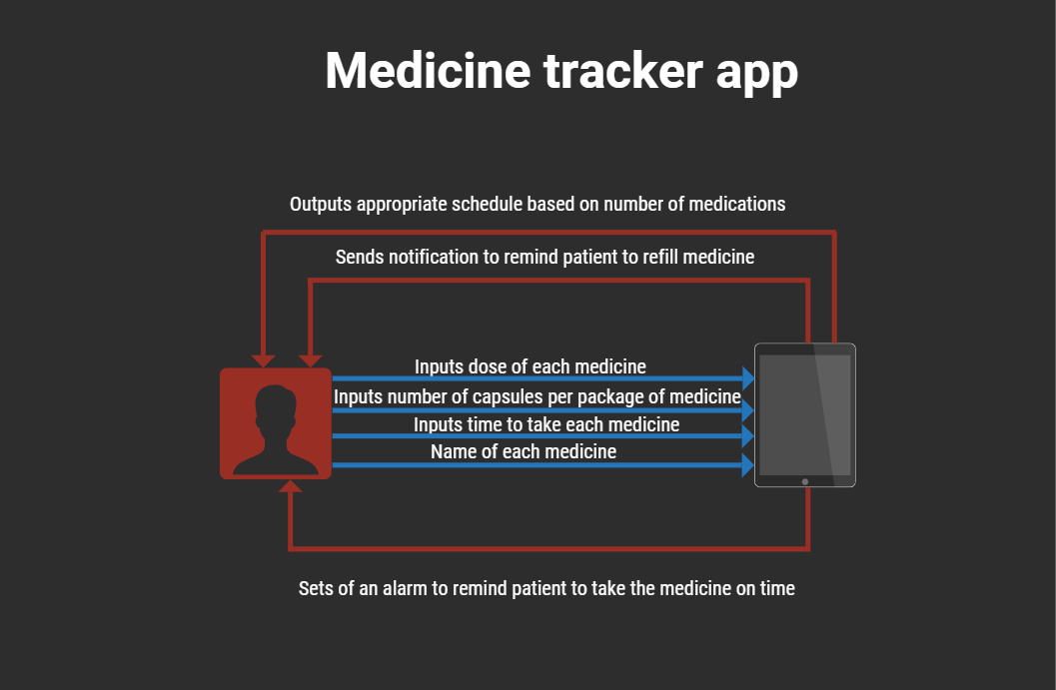
FLUTTER MEDICINE TRACKER AND NOTIFICATION APP
THE DEPARTMENT OF
Computer Science
Mark Emad | Yossef Mohamed | Seif Hany | Youssef Khaled
89603 | 89551 | 89568 | 94246
Supervised by: Dr. Alaa Zaghloul
TA.: Eng. Rahma waleed & Eng. Omar Ayman
Problem Definition
Results
Abstract
The effective management of medication intake poses a significant challenge for individuals in today's fast-paced society. Many people struggle to remember their prescribed medication schedules, resulting in missed doses and potential health consequences. Furthermore, keeping track of multiple medications, their appropriate dosages, and refill requirements can be overwhelming and prone to errors. To address these pressing issues, we recognize the need for a robust and user-friendly medicine tracker mobile application. Our goal is to develop a comprehensive solution that not only reminds users to take their medications on time but also assists in ensuring accurate dosages and timely refills. By leveraging the capabilities of smartphones, we aim to provide individuals with a convenient and reliable tool that simplifies medication management. The core problem we aim to solve is the lack of a streamlined and personalized approach to medication adherence.
Our objective is to create a mobile application designed to redefine the way individuals manage their medications. In today's fast-paced world, medication adherence is a significant challenge, leading to adverse health outcomes and increased healthcare costs. With a focus on user-centric design and advanced functionality, our app aims to empower users to effortlessly track, monitor, and optimize their medication regimens. The app offers a seamless and intuitive experience, allowing users to effortlessly input and manage their medication schedules. Through personalized reminders and alerts, users are guided to take their medications at the prescribed times, ensuring no dose is missed. The application also enables users to track their medication intake and maintain a comprehensive logbook, providing an invaluable resource for healthcare professionals during consultations.
Methodology
Rapid application development (RAD) is a software development methodology, which favors iterative development and the rapid construction of prototypes instead of large amounts of up-front planning. The key benefit of a RAD approach is fast project turnaround.
Introduction
In the era of universal mobile devices and smartphones, we have a remarkable opportunity to harness the power of technology to improve people's lives. Our intuitive medicine tracker mobile application leverages the usage of smartphones to assist patients and individuals in adhering to their prescribed medication regimens. By seamlessly integrating with users' daily routines, our application delivers timely reminders and notifications, ensuring optimal medication adherence and promoting overall well-being. There is no need to rely solely on memory or external tools to manage medication schedules. Our comprehensive application goes beyond a mere pill alarm, offering a sophisticated medication tracking system. With just a glance at the intuitive pill log, users can effortlessly verify whether they have taken their crucial doses eliminating uncertainty and enhancing peace of mind. Since the essence of our application is convenience and efficiency, our application encompasses an array of features designed to cater to users' diverse needs. From medication reminders to refill alerts and text recognition, our all-encompassing solution consolidates all essential aspects of medication management into a single, user-friendly platform. The importance of medication adherence cannot be overstated, particularly for individuals who juggle multiple prescriptions daily. Our application plays a pivotal role in help health and mitigating the risk of adverse health consequences. Extensive research reveals that nearly 50% of individuals struggle to adhere to their prescribed medications. Our mission is to bridge this gap by not only providing reminders but also ensuring users follow their prescribed medication regimens accurately and effectively.
System architecture
Acknowledgement
First, we are very grateful to Almighty Allah who gave us opportunity, strength, determination and wisdom to achieve our goal. Without His support, this could not have been possible. Though only our names appear on the cover of this dissertation, a great many people have contributed to its production. We owe our gratitude to all those people who have made this dissertation possible and because of whom our graduate experience has been one that we will cherish forever. Foremost, we would like to express our sincere gratitude to our advisor Dr. Alaa Zaghloul for the continuous support of our project study and research, for his patience, motivation, enthusiasm, and immense knowledge. His guidance helped us in all the time of research and writing of this research. We could not have imagined having a better advisor and mentor for our project study. We also wish our sincere thanks and appreciation to Dean. Dr. Rania Elgohary for her support of us all the time.

